Slide 1

Unit-2 Ancient The Vedas Corpus & Psychological States (Yoga)
Indian Knowledge System
#2301DU005
Prof. Deepraj K. Patadia
Civil Engineering Department
deepraj.patadia@darshan.ac.in
7990475865

Slide 2

Looping
Introduction to Indian Knowledge System
History of Vedas
Yajna Organization
4 Vedas, its Brief Introduction and its analysis
History of Yoga
Yoga Way of Life
Physical Exercise - Yoga (Asanas)
Mental Exercises: Meditation - Yoga (Pranayama, Sukshma Kriyas)
Importance of Balanced Life

Slide 3

History of Vedas

Slide 4
3000 BCE: The Aryans - nomadic northerners from central Asia - possibly begin to migrate into the Indus Valley in an early phase of migration.
1500 BCE - 1100 BCE: The Rig Veda written, mentioning the god Rudra (Shiva) and goddess Tara (among others) for the first time.
1500 BCE - 500 BCE: The Vedic Period in India after a greater migration of the Indo-Aryans from Central Asia
1500 BCE - 500 BCE: Indian scholars of the so-called Vedic Period commit the Vedas to written form; basic tenets of Hinduism are established.
Notes:
https://www.worldhistory.org/The_Vedas/

Slide 5
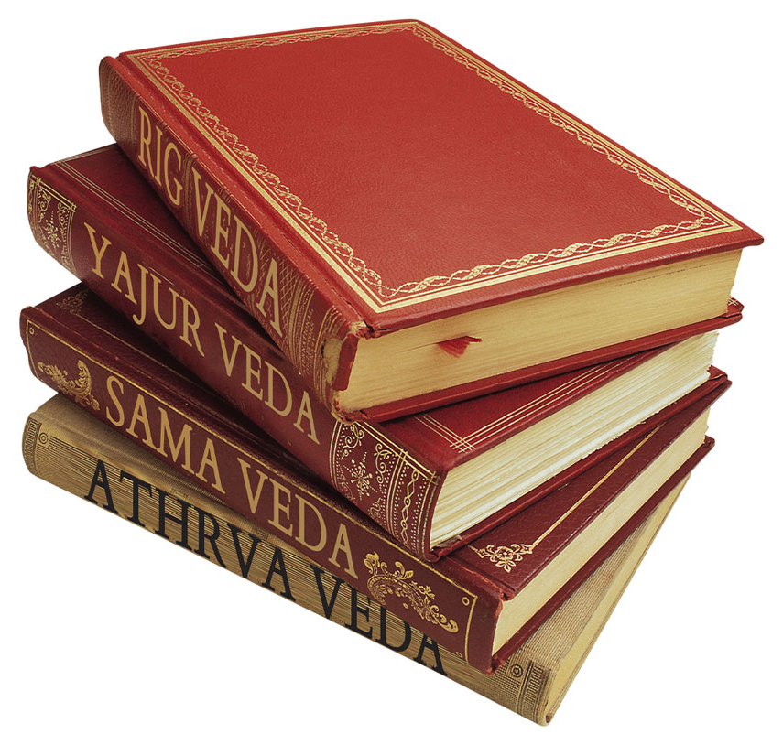
History of Vedas
The word Veda is generally derived from the Sanskrit root विद् (vid - to know). The word Veda can be derived from five verbal roots.
These mean to exist, to know, to discriminate, to obtain, and to make known.
Veda indicates a vast body of knowledge concerning the eternal spiritual values and principles and practices for gainful and happy living revealed to the rșis(rishis) through their deep meditation.
The Hindu religious tradition has accorded the Vedas the highest place in its canonical (પ્રમાણભૂત) literature and are revered (આદરણીય) as the basic scriptures.
It is believed in the Indian tradition that the Veda is the poetry of Gods and it neither fades nor becomes stale by the passing of time.

Slide 6

History of Vedas
The actual dating of the Vedas has been a subject matter for considerable debate.
The latest date attributed by many modern researchers falls a few millennia before the common era.
Vedas are a unique repository of knowledge that distinguishes itself from other forms of knowledge.
Normally, we attribute knowledge to a person. However, the Vedic corpus is generally understood as a non-human source (known as Apauruşeya).
Vedas are revealed to the Rsis from time to time in their state of deep contemplation (ચિંતન).
That is why it is apauruşeya. Despite this, we will find that specific Vedic mantras are associated with certain Rsis.

Slide 7
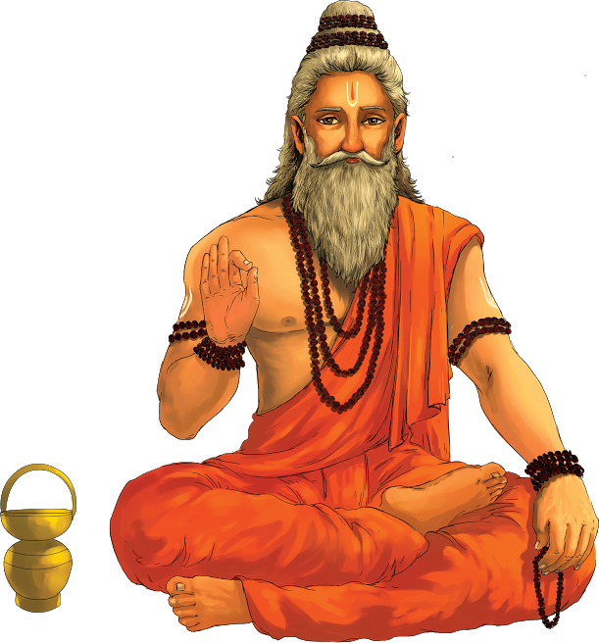
History of Vedas
The Rşis are associated with certain mantras, not as authors but as those who indeed discovered the mantra through their deep concentration and focus.
In this sense, the Rșis of the Vedic lore (વિદ્યા) are 'seers(દ્રષ્ટા)' of the mantras and not the authors.
Veda is transmitted orally and preserved intact from time immemorial.
Vedas have a well-developed system of phonetics that has ensured its preservation.
Recognized by UNESCO as heritage.

Slide 8
History of Vedas
The Vedic repository is preserved and transmitted through an oral tradition.
Hence, the Vedas are referred to as śruti, 'what is heard'. From an operational perspective, the Vedic knowledge was transmitted in an unbroken line of transmission from teacher to student that was formalized early on.
It has survived several thousand years on account of scientific methods of oral rendering.
This has been possible on account of a well-developed system of phonetics, known as Šikșă (શિક્ષા), one of the vedängas.
This ensured an impeccable (દોષરહિત) textual transmission superior to the classical texts of such antiquity.
This is perhaps the reason for the UNESCO recognizing the Vedas as a heritage for preservation.

Slide 9
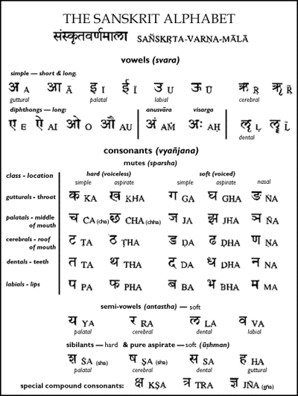

Slide 10
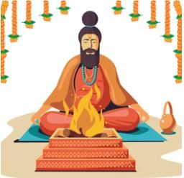
History of Vedas
The seers concluded that the purpose of human life is to realize oneself, rid oneself of limitations and constraints, and experience bliss by knowing the absolute truth.
Given this objective, they proposed a path for the evolution of an individual. During the early stage of one's life, each one of us is supposed to engage in the world of activities, contribute actively, and enjoy a secured living.
Towards this end, the seers proposed the Karma-kända. The karma- kända nudges an individual to obtain a purity of mind as we engage with the world.
Since the Vedic living was centrally focused on Yajña, several instructions and operating frameworks pertaining to the Yajña (યજ્ઞ) form part of the karma-kända.

Slide 11
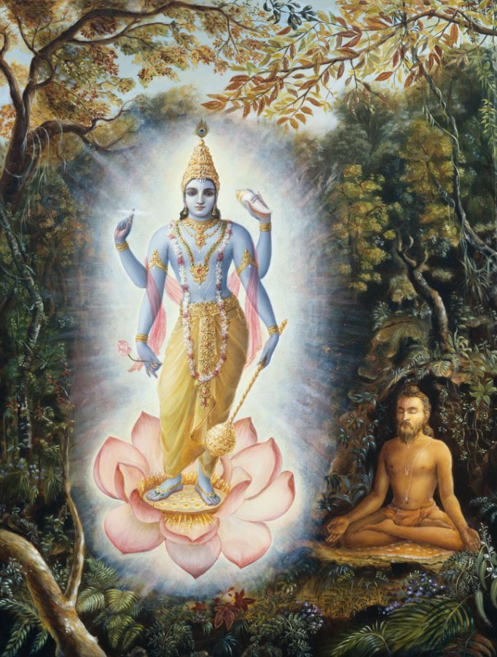
History of Vedas
As individuals progress, there is a need for single pointedness of the mind through contemplation and focus. In the Vedic corpus, the Upasana-kända provides these ideas for an individual.
The word Upăsană literally means sitting near. (Upa äsanä).
It is a method of developing a certain attitude to worship. In simple terms, Upäsană refers to a state of concentration where 'whatever is meditated upon' is completely identified and absorbed with self.
It provides a systematic method and an opportunity to harness the inherently wandering mind towards a defined goal through contemplation.

Slide 12
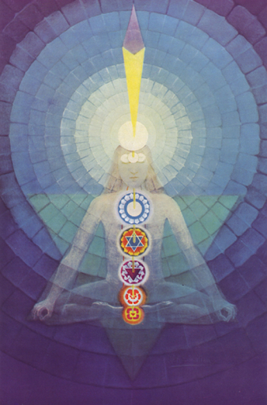
History of Vedas
Through systematic practices prescribed in the upāsana-kända, an individual will be able to develop calmness of the mind and mental equipoise.
Several meditation practices are prescribed in the Vedas as part of the Upāsană ideas.
A purified and sharpened mind becomes a storehouse of energy, and it enables an individual to perform very effectively both in his professional life as well as in his meditative practices.
The other part of the Veda addresses the issue of self-realization.
The Jñāna-kända opens the mind of an individual to its limits and facilitate much deeper inquiry about oneself.

Slide 13
History of Vedas
The Western approach to the study of the Vedic corpus has primarily been in extracting the archival material and publishing them afresh, with English in extracting commentaries.
In the Western approach, they often view the entire exercise as purely intellectual and linguistic in nature.
Since most of them would have had very little opportunity to experience and imbibe native traditions, the work could ignore or overlook traditional and cultural dimensions that are required to present the knowledge in an appropriate context and perspective.
Moreover, the Western works generally ascribe (ગણાવવું) to the Aryan invasion theory and use that as one of the main lenses to study the Vedic scriptures. One needs to be aware of these aspects while dealing with such works.

Slide 14
Yajna (યજ્ઞ) Organization

Slide 15
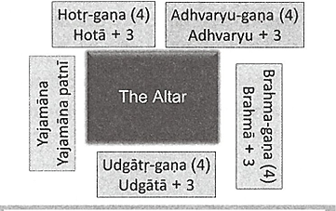
Yajna Organization

Slide 16
Yajna Organization
Participant | Role | Description
Yajamana | Patron | The individual who sponsors and performs the Yajna, often the head of a household or a king.
Ritviks | Vedic Priests | The priests who conduct the Yajna, each with specific roles.
Hotri | Rigveda Reciter | Recites hymns from the Rigveda.
Adhvaryu | Yajurveda Performer | Performs the physical aspects of the Yajna, reciting from the Yajurveda.
Udgatri | Samaveda Singer | Sings hymns from the Samaveda.
Brahma | Supervisor | Oversees the Yajna, knowledgeable in all Vedas, ensures correctness and rectifies errors.

Slide 17
Yajna Organization
ભાગીદાર | ભુમિકા | વર્ણન
યજમાન | પેટ્રન | તે વ્યક્તિ જેઓ યજ્ઞને પ્રાયોજિત અને અનુષ્ઠાન કરે છે, સામાન્ય રીતે ઘરના વડા અથવા રાજા.
રિત્વિક | વિદ્વાન બ્રાહ્મણ | યજ્ઞને અનુષ્ઠાન કરનારા બ્રાહ્મણ, દરેકની વિશિષ્ટ ભૂમિકાઓ સાથે.
હોત્રી | ઋગ્વેદ પઠનક | ઋગ્વેદમાંથી સચ્ચિતોનું પઠન કરે છે.
અધ્વર્યુ | યજુર્વેદ અનુષ્ઠાનક | યજ્ઞની શારીરિક બાબતોને અનુષ્ઠાન કરે છે, યજુર્વેદમાંથી પાઠ કરે છે.
ઉદ્ગાત્રી | સામવેદ ગાયકો | સામવેદમાંથી ગીતો ગાવે છે.
બ્રહ્મા | નિયામક | યજ્ઞની દેખરેખ કરે છે, તમામ વેદોમાં કુશળ, ખોટા બાબતોને સુધારવા માટે જવાબદાર છે.

Slide 18
Understanding Vedic Divisions
The Yajnas, or sacrificial rituals, were pivotal in the Vedic tradition. They were seen as essential for maintaining the cosmic order and pleasing the gods.
Every major event in the life of a Vedic person, from birth to death, involved Yajnas. These rituals were integral to festivals, agricultural cycles, and personal milestones.
Role of Yajnas
Agni, the fire god, was believed to be the mediator between humans and gods, carrying offerings to the divine beings.
People performed Yajnas to ask for prosperity, good health, and spiritual progress. These rituals were thought to ensure the well-being of individuals and the community.
Yajnas were also a way to thank the gods for their generosity and the benefits received by individuals and society.

Slide 19
Understanding Vedic Divisions
Vedic Knowledge and Rituals
The Vedas provided comprehensive instructions on how to perform Yajnas, including the specific mantras to chant, materials to use, and the precise procedures to follow.
Over centuries, a highly developed system for conducting Yajnas emerged, reflecting an advanced understanding of ritual practice and spiritual discipline.
Project Management Insight
The execution of a Yajna required meticulous (ઝીણવટભર્યું) planning, coordination, and teamwork, akin (સમાન) to modern project management.
Different participants had specialized roles, ensuring that each aspect of the ritual was performed correctly and efficiently.

Slide 20
Yajna Organization
The Yajamana (the sponsor of the Yajna) and his wife were crucial as they had personal stakes in the success of the ritual, often seeking divine favor or expressing gratitude.
The Yajna required a team of 18 people, divided into four groups of four, each with expertise in different Vedic texts and ritual functions along with the Yajamana and his wife.
Group 1: Hotr-gana
This group comprised a lead priest (Hotr) and three assistants who were well-versed in the Rigveda.
Their primary role was to chant hymns(સ્તોત્રો) from the Rigveda to invoke and invite the gods to the ritual.

Slide 21
Yajna Organization
Group 2: Adhvaryu-gana
This group included priests proficient in the Yajurveda, which deals with the procedural aspects of the rituals.
They were responsible for the physical execution of the Yajna, including making offerings to the fire and ensuring that the ritual followed the correct sequence.
Group 3: Udgatr-gana
This group specialized in the musical chants and hymns of the Samaveda.
They sang the appropriate hymns to praise the gods, enhancing the spiritual atmosphere of the Yajna.

Slide 22
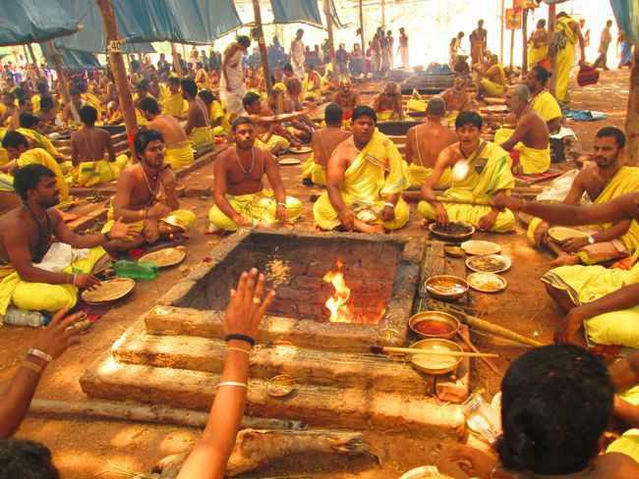
Yajna Organization
Group 4: Brahma-gana
This group consisted of priests with deep knowledge of the Atharvaveda, which includes spells and incantations (મંત્ર).
They acted as overseers, ensuring the ritual was performed according to the prescribed methods.
They intervened to correct any mistakes and resolved any problems that arose during the Yajna.

Slide 23
Yajnas: Scale and Management
Scale of Yajnas
Yajnas could range from small, simple rituals lasting a few hours to large, elaborate ceremonies spanning several days.
Larger Yajnas required substantial resources, including time, materials, and personnel, and often involved the entire community.
The successful execution of a Yajna depended on advanced planning, resource allocation, and coordination among the participants.
The Vedic people's ability to manage and execute complex Yajnas showcased their organizational skills and attention to detail.
Yajnas were not just religious rituals but were central to the social and cultural fabric of Vedic society, influencing community structure and governance.

Slide 24
The Four Vedas

Slide 25
The Four Vedas
Types of Vedas
Name of the Veda | Key Features of the Veda
Rig Veda | It is the earliest form of Veda
Samaveda | The earliest reference for singing
Yajurveda | It is also called the book of prayers
Atharvaveda | The book of magic and charms

Slide 26

Rigveda
Vedas were three originally & known as Trayi Vidya.
Rigveda is the oldest.
Collection of 10 books called ‘Mandalas’.
1028 total hymns (સ્તોત્રો) called ‘Suktas’.
Oldest known vedic Sanskrit text (1800-1100 BCE).
Meaning of the word ‘Rigveda’ is to Praise Knowledge. It has 10600 verses.
The book number 1 & 10 were written before the other books.
Book number 2 to 9 deals with the cosmology (બ્રહ્માંડ વિજ્ઞાન) & deities.

Slide 27
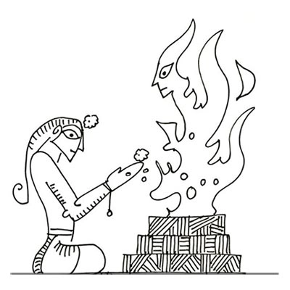
Rigveda
Rigvedic books 1 and 10 deal with philosophical questions (તત્વજ્ઞાન) and also talk about various virtues including charity in the society.
Rigvedic books 2-7 are the oldest and shortest also called family books.
Rigvedic books 1 & 10 are the youngest and longest.
1028 hymns deal with deities including Agni, and Indra and are attributed and dedicated to a Sage Rishi.
The 9th Rigvedic book/mandala is solely dedicated to Soma.

Slide 28
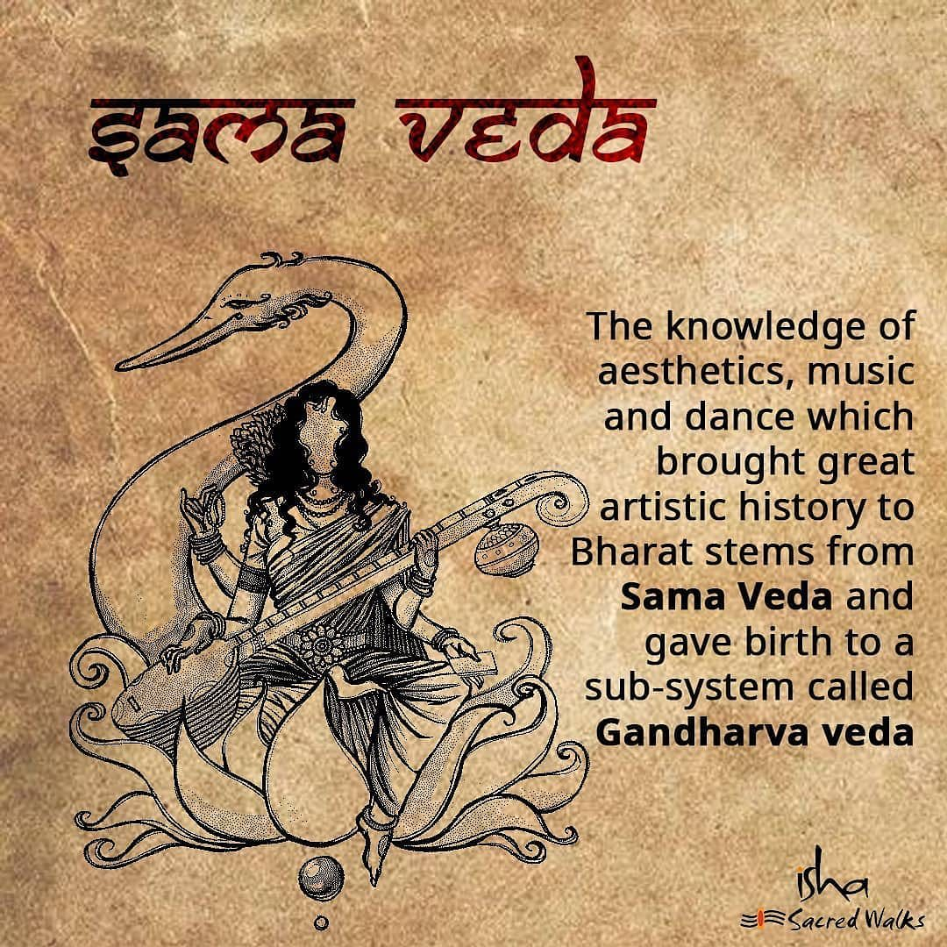
Samaveda
The Samaveda, dating back to 1200-800 BCE, is known as the Veda of melodies and chants and is associated with public worship.
There are 1549 verses (except 75 verses, all have been taken from Rigveda).
There are two Upanishads embedded in Samaveda – Chandogya Upanishad and Kena Upanishad.
The Samaveda is considered as the root of the Indian classical music and dance.
It is considered as the storehouse of the melodious chants.

Slide 29
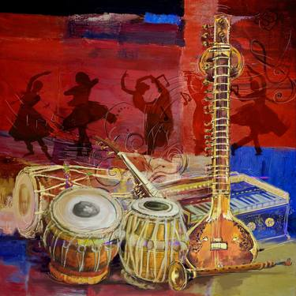
Samaveda
Though it has fewer verses than Rigveda, its texts are larger.
Samaveda is categorized into two parts – Part-I includes melodies called Gana & Part-II includes a three-verses book called Archika.
Samaveda Samhita is not meant to be read as a text, it is like a musical score sheet that must be heard.

Slide 30
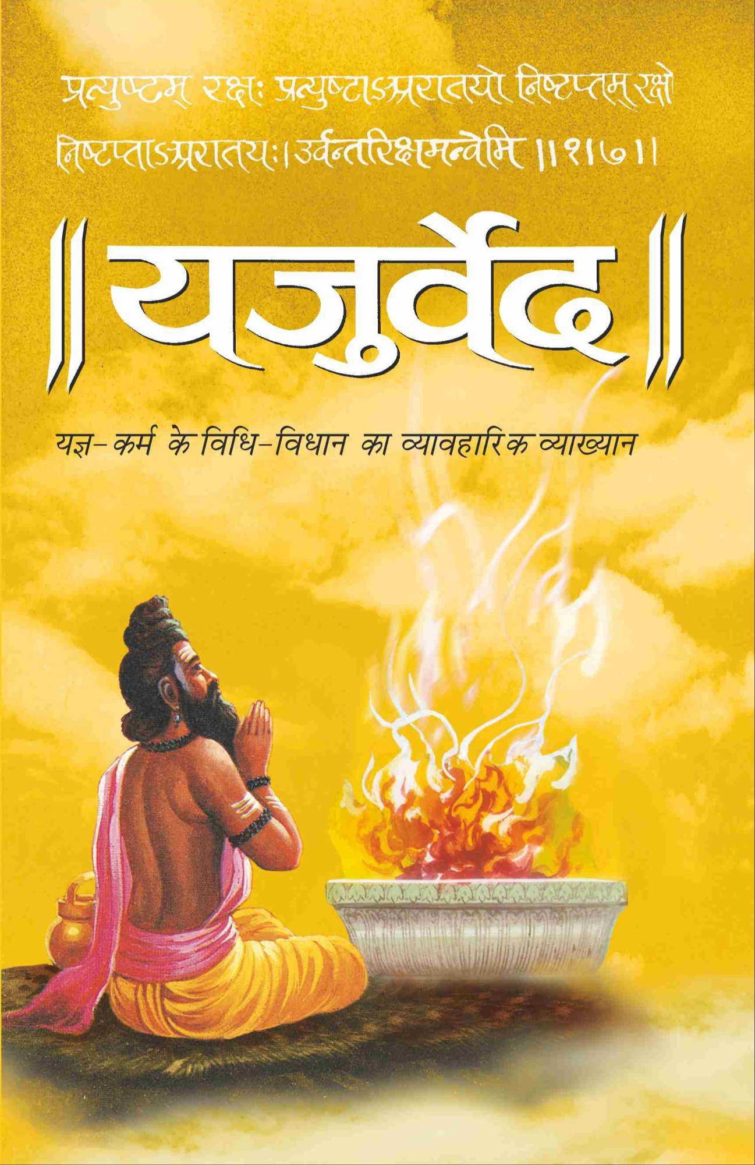
Yajurveda
Stands to mean ‘Worship Knowledge’, Yajurveda dates back to 1100-800 BCE; corresponding with Samaveda. It compiles ritual-offering mantras/chants. These chants were offered by the priest alongside a person who used to perform a ritual (in most cases yajna fire).
It has two types – Krishna (Black/Dark) & Shukla (White/Bright).
Krishna Yajurveda has an un-arranged, unclear, motley collection of verses.
Shukla Yajurveda has arranged and clear verses.
The oldest layer of Yajurveda has 1875 verses mostly taken up from Rigveda.

Slide 31
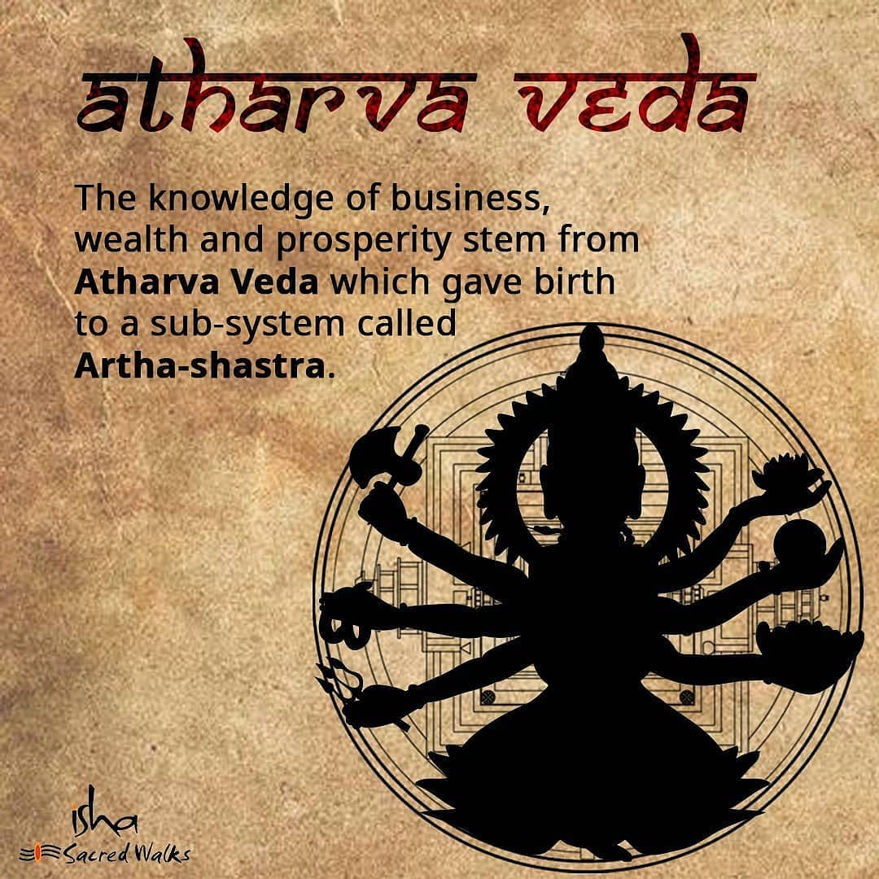
Atharvaveda
Stands to mean a tatpurusha compound of Atharvan, an ancient sage, and knowledge (Atharvan + knowledge), it dates back to 1000-800 BCE.
The daily procedures of life are very well enumerated in this Veda.
It has 730 hymns/suktas, 6000 mantras, and 20 books.

Slide 32
Atharvaveda
Called a Veda of magical formulas, it includes three primary Upanishads – Mundaka Upanishad, the Mandukya Upanishad, and the Prashna Upanishad.
The 20 books are arranged by the length of the hymns they contain.
Unlike Samaveda where hymns are borrowed from Rigveda, hymns of Atharvaveda are unique except for a few.
This Veda contains hymns many of which were charms and magic spells which are meant to be pronounced by the person who seeks some benefit, or more often by a sorcerer (જાદુગર) who would say it on his or her behalf.

Slide 33
Atharvaveda
Name | Description
भैषज्याणी (Bhaisajyani) | Mantras which refer to various medicines for different diseases.
आयुष्याणी (Ayusyani) | Mantras for long life.
पौष्टिकानी (Paustikani) | Mantras to be recited at the time of ploughing the field, on the occasion of house construction or while exercising certain commercial transactions.
प्रायश्चित्तानि (Prayscittani) | Mantras which do away with the bad and inauspicious matters.
स्त्रीकर्मानी (Strikarmaini) | Mantras are exclusively related to the life of woman folk, e.g. marriage, love, child welfare and so on.
राजकर्मणी (Rajakarmaini) | Mantras on political notions of the Vedic times.
ब्राह्मण्यानी (Brahmanyani) | Mantras on philosophical speculations of the Atharvaveda.

Slide 34
Summary of Vedas
Veda | Time Period | Key Features | Content | Language | Purpose
Rigveda | 1500-1200 BCE | Oldest Veda | 1,028 hymns in 10 books praising deities | Early Vedic Sanskrit | Insights into early Vedic religion, culture, and society
Samaveda | 1200-800 BCE | Melodies and chants | Derived from Rigveda, focusing on music and chants | Vedic Sanskrit | Public worship and rituals
Yajurveda | 1200-800 BCE | Rituals and sacrifices | Prose mantras and instructions for rituals | Vedic Sanskrit | Guidelines for religious ceremonies and sacrifices
Atharvaveda | Around 1000 BCE | Magical spells and healing rituals | Hymns, charms, spells for everyday issues | Vedic Sanskrit | Protection against diseases, disasters, malevolent forces

Slide 35
The Four Divisions of Each Veda
Each Veda includes four major parts
Samhitas
Brahmanas
Aranyakas
Upanishads

Slide 36
Organization of Each Veda
Part | Description
Samhitas | Collections of hymns, chants, and mantras used in rituals and ceremonies.
Brahmanas | Prose texts explaining the Samhitas, providing instructions and explanations for rituals.
Aranyakas | "Forest books" with meditative and philosophical content, serving as a transition from rituals to philosophy.
Upanishads | Philosophical texts focusing on spiritual knowledge, exploring concepts like Brahman, Atman, and self-realization.

Slide 37
Organization of Each Veda
Part | Description
Samhitas | ધાર્મિક વિધિઓ અને સમારંભોમાં ઉપયોગમાં લેવાતા સ્તોત્રો, મંત્રો અને મંત્રોનો સંગ્રહ
Brahmanas | સંહિતાઓને સમજાવતા ગદ્ય ગ્રંથો, ધાર્મિક વિધિઓ માટે સૂચનાઓ અને સમજૂતીઓ પ્રદાન કરે છે.
Aranyakas | ધ્યાન અને દાર્શનિક સામગ્રી સાથે "વન પુસ્તકો", ધાર્મિક વિધિઓથી ફિલસૂફીમાં જ​વા માટે
Upanishads | દાર્શનિક ગ્રંથો આધ્યાત્મિક જ્ઞાન પર ધ્યાન કેન્દ્રિત કરે છે, બ્રહ્મ, આત્મા અને આત્મ-અનુભૂતિ જેવી વિભાવનાઓની શોધ કરે છે.

Slide 38
The Four Divisions of Each Veda
The Vedic texts are structured into distinct divisions, each serving specific purposes and audiences
Samhita (Mantras): Hymns dedicated to devatas, offering praise and invocation.
Brahmanas: Detailed instructions and guidelines for conducting yajna rituals.
Aranyakas: Encouraging deep contemplation on human nature, the universe, and our relationship with the divine.
Upanishads: Philosophical treatises (ગ્રંથો) exploring the nature of reality, consciousness, and spirituality.
Sage(ઋષિ) Vyasa categorized each Veda based on content, audience, and objectives, creating a structured hierarchy that remains foundational to Vedic knowledge.

Slide 39
Organization of Each Veda
Samhitas
The Samhitas are the first part of each of the Vedic texts.
It constitutes mantras or hymns dedicated to deities and the natural world.
Comprises a significant number of mantras presented in metrical form.
For instance, the Rigveda-Samhita contains 10,552 mantras.
Each mantra identifies the rishi (seer) who discovered it, the devata (deity) it addresses, and the meter used in its composition.
Prominent devatas addressed include Indra, Agni, Varuna, and Mitra, with Indra and Agni receiving the highest number of hymns.
Notably, there were 25 women rishis who composed hymns in the Rigveda, contributing to its rich diversity.

Slide 40
Organization of Each Veda
Brahmanas
The Brahmanas compose the second section of the Vedas.
They are prose commentaries that try to explain the significance of rituals and sacrifices mentioned in the Samhitas.
The mantras became more difficult to understand for younger generations as time passed.
Hence, it became necessary to provide a detailed explanation of the situation.
Consequently, the Brahmanas’ are self-explanatory in style.

Slide 41
Organization of Each Veda
The term "Brahmana" in Vedic context refers to a collection of texts primarily focused on rituals and rites.
Brahmanas are extensive texts within each Veda, detailing rituals and their significance. They often include commentaries and explanatory notes on the mantras from the Samhitas.
Examples
Aitareya Brahmana: Describes rituals such as Soma sacrifice and Agnihotra.
Kaushitaki Brahmana: Covers food sacrifices, full-moon rites, and seasonal ceremonies.
Satapatha Brahmana: Provides instructions on complex rituals like Agnicayana and Ashvamedha.

Slide 42
Organization of Each Veda
Brahmanas specify the reasons for rituals, prescribe the mantras to be recited, and give detailed instructions for ritual preparations, such as building the ceremonial platform (Uttara-vedi).
They contain technical material that may not appeal to general readers but is crucial for understanding Vedic ritual practices and their symbolic meanings.
The Atharvaveda, for example, includes the largest collection of Brahmanas, with significant texts like the Pancavimsa Brahmana detailing the conduct of important rituals like Somayajna.
Each Brahmana, such as the Sadvimsha Brahmana, addresses various topics including the origin of Agni and remedies for societal and natural challenges.

Slide 43
Organization of Each Veda
Aranyakas
The Aranyakas are the third section of the Vedas and serve as a bridge between the ritualistic Brahmanas and the philosophical Upanishads.
They were created by the ascetics, who migrated to the forests in search of spiritual fulfillment.
The lack of resources in the forests forced them to devise a new way to continue their sadhana, as they were unable to carry out the conventional yajnas or perform rituals.
That is when the Aranyakas were created to serve as a guide to meditation.
These texts do not place a high value on rituals and sacrifices, preferring to focus on philosophy and meditation instead.

Slide 44
Organization of Each Veda
Upanishads
Explores the relationship between the individual (jiva), the universe (Jagat), and the divine force (Ishvara).
Contain the Maha-vakyas, profound pronouncements about truth.
Originally, there may have been over 1,180 Upanishads, but only around 200 are known Upanishads, of which only 108 are currently available.
The loftiest thoughts of the Vedic seers are expressed in the Upanishads.
Philosophical treatises addressing life's ultimate problems.
"Upanishad" means "sitting near a Guru" and receiving wisdom.
Different approaches to impart knowledge in the Upanishads.

Slide 45
Organization of Each Veda
In-depth study of human nature and psychology.
Ten principal Upanishads extensively commented upon and frequently referenced by great spiritual masters in India.
Additional 4-5 Upanishads also popular and frequently mentioned by spiritual leaders.
They also serve as a fountainhead of knowledge and wisdom, guiding us to lead successful lives as we pursue material benefits for happiness.
A profound example is the concluding anuvaka in the Shiksha Valli of the Taittiriya Upanishad, which features the Guru's final address to his students as they graduate from the gurukul.
This can be likened to a modern-day convocation speech.

Slide 46
Vedanga
During earlier times, the Vedic language was easy to recite and understand.
Over time, natural changes occurred in the spoken language, drifting away from the Vedic language.
People needed support to read and comprehend the Vedic text.
Due to the importance of Vedic texts, significant effort has gone into preserving the text in its original form.
A specific body of knowledge, practices, tools, and techniques was created to preserve the Vedas and use them appropriately.
These efforts became an integral part of the Vedic literature, known as Vedangas, literally "limbs of the Vedas."

Slide 47
Vedanga
Six complementary requirements for the preservation and proper use of the Vedic corpus
Vedic texts being oral in nature must be preserved in their original form, requiring precise listening and reproduction of sounds.
Words and sentences of the text must be understood without ambiguity.
The metres to which the mantras are set must be systematically understood and their rules properly followed.
A complete guide to lead a life as prescribed in the Vedas is needed, with clear practices and norms for various activities.
A properly structured set of instructions for performing Vedic rituals, from building the yajna-sala to carrying out elaborate rituals such as the soma-yagas, must be established.
A method to fix the time for all prescribed activities is necessary.

Slide 48
Vedanga
There are six Vedangas addressing these roles
Siksha (Phonetics)
Nirukta (Etymology
વ્યુત્પત્તિશાસ્ત્ર)
Kalpa (Ritual Instructions)
Vyakarana (Grammar)
Chandas (Metre)
Jyotisha (Astronomy and Astrology)

Slide 49
Vedanga
The seeds of all these Vedangas are found in the Vedas themselves.
People wrote elaborate texts on these topics, updating them as needed.
Several texts authored at different times help decipher the Vedic texts and know their practical applications.
Vedanga texts also have practical applicability in other fields.
Examples
Panini's Ashtadhyayi (Grammar)
Pingala's Chandahsastra (Metre)
Sulba-sutras (Geometry)
Various works related to Jyotisha-sastra (Astronomy and Astrology)

Slide 50
Siksha
The word Siksha means “to acquire knowledge”.
In the Vedic context, Siksha deals with pronunciation.
Siksha was the first thing taught in the ancient educational system.
Described briefly in the Taittiriya Upanishad and elaborated in Siksha-shastra.
Siksha is the science of pronunciation, crucial for preserving the Vedic text from corruption.
Siksha directs attention to all details of the pronunciation process.
Siksha-shastra is a systematic approach to phonetics.
Defines characteristics of basic sound units (varna) and explains sound production.
Several books on Siksha-shastra, with Paniniya-Siksha being the most popular, attributed to Panini, the famous grammarian.

Slide 51

Siksha
Famous Text on Sikṣā Paṇiniya-śikṣā, attributed to the grammarian Pāṇini, is a widely studied text on Sikṣā.
It discusses Rasayana (therapeutic supplements), Bhasmas (metal/mineral preparations), and Pañcakarma (cleansing therapies) in Ayurvedic medicine.

Slide 52
Vedanga
Vedanga | Focus | Purpose | Components | Notable Texts
Shiksha | Phonetics | Ensures correct pronunciation of Vedic hymns and mantras | Sounds, accents, intonations, articulation | Paniniya Shiksha, Yajnavalkya Shiksha
Chandas | Prosody | Analyzes structure and pattern of Vedic verses | Various meters (e.g., Gayatri, Anushtubh, Trishtubh) | Pingala's Chandas Shastra
Vyakarana | Grammar | Provides rules for correct formation of words and sentences | Syntax, morphology, phonetics | Panini's Ashtadhyayi
Nirukta | Etymology | Clarifies meanings of obscure or complex Vedic words | Origins and meanings of words | Yaska's Nirukta
Kalpa | Rituals | Provides instructions for performing Vedic rituals | Shrauta Sutras, Grihya Sutras, Dharma Sutras, Sulba Sutras | Apastamba Sutra, Baudhayana Sutra, Katyayana Sutra
Jyotisha | Astronomy and Astrology | Determines auspicious timing for rituals and ceremonies | Study of celestial bodies, timekeeping, astrological predictions | Vedanga Jyotisha, Brihat Samhita

Slide 53
Upanishads contained in Vedas
Veda | Upanishads
Rigveda | Aitareya Upanishad
Samaveda | Chandogya Upanishad, Kena Upanishad
Yajurveda | Brihadaranyaka Upanishad, Isha Upanishad, Taittiriya Upanishad, Katha Upanishad, Shvetashvatara Upanishad
Atharvaveda | Mundaka Upanishad, Mandukya Upanishad, Prashna Upanishad

Slide 54
A Summary of the Content in the Four Veda

Slide 55
A Summary of Vedas, Vedangas, Upnishada & Puranas
Category | Relation to Vedas | Description
Vedas | Rigveda, Samaveda, Yajurveda, Atharvaveda | The primary texts of ancient Indian wisdom, containing hymns, chants, rituals, and philosophical discussions.
Vedangas | Shiksha, Chandas, Vyakarana, Nirukta, Kalpa, Jyotisha | Supplementary texts that provide support for understanding and practicing the Vedas:
 | Shiksha: Pronunciation and phonetics | Ensures correct pronunciation of Vedic hymns and mantras.
 | Chandas: Prosody | Analyzes the meter and structure of Vedic verses.
 | Vyakarana: Grammar | Provides rules for the correct formation of words and sentences in Vedic texts.
 | Nirukta: Etymology | Explains the meanings and origins of difficult Vedic words.
 | Kalpa: Rituals | Provides practical instructions for performing Vedic rituals and ceremonies.
 | Jyotisha: Astronomy and Astrology | Determines auspicious timing for rituals and ceremonies based on the study of celestial bodies.
Puranas | Various Puranas (e.g., Vishnu Purana, Shiva Purana) | Later texts that narrate mythological stories, traditions, and religious teachings, often elaborating on Vedic themes.
Upanishads | Various Upanishads (e.g., Chandogya Upanishad, Brihadaranyaka Upanishad) | Philosophical and spiritual texts that explore deeper metaphysical concepts and ideas found in the Vedas.

Slide 56
A Summary of Vedas, Vedangas, Upnishada & Puranas
Category | Relation to Vedas | Description
વેદો | Rigveda, Samaveda, Yajurveda, Atharvaveda | પ્રાચીન ભારતીય જ્ઞાનના મુખ્ય ગ્રંથો, જેમાં ગીતો, માન્ત્રો, વિધિઓ અને તત્ત્વજ્ઞાન ચર્ચાઓ સમાવેશ થાય છે.
વેદાંગો | Shiksha, Chandas, Vyakarana, Nirukta, Kalpa, Jyotisha | વેદોને સમજવા અને પ્રેક્ટિસ કરવા માટે પૂરક ગ્રંથો:
 | શિક્ષા: ઉચ્ચાર અને ધ્વનિશાસ્ત્ર | વેદી ગીતો અને માન્ત્રોનું યોગ્ય ઉચ્ચાર સુનિશ્ચિત કરે છે.
 | છંદ​ | વેદી શ્લોકની માત્રા અને રચનાને વિશ્લેષણ કરે છે.
 | વ્યાકરણ | વેદી ગ્રંથોમાં શબ્દો અને વાક્યોની યોગ્ય રચનાના નિયમોને પ્રદાન કરે છે.
 | નિક્ત: વ્યાખ્યાવિદ્યાનો | અસ્પષ્ટ અથવા જટિલ વેદી શબ્દોના અર્થ અને ઉત્પત્તિ માટે સ્પષ્ટીકરણ આપે છે.
 | કલ્પ: વિધિઓ | વેદી વિધિઓ અને રીતિઓ માટે વ્યાવહારિક સૂચનાઓ પ્રદાન કરે છે.
 | જ્યોતિષ: ખગોળશાસ્ત્ર અને જ્યોતિષ | આકાશમંડળના અભ્યાસના આધારે વિધિઓ અને વિધિઓ માટે શુભ સમય નિર્ધારિત કરે છે.
પૂરાણો | વિવિધ પુરાણો (જેમ કે વિષ્ણુ પુરાણ, શિવ પુરાણ) | પછીના ગ્રંથો જે પૌરાણિક વાર્તાઓ, પરંપરાઓ અને ધાર્મિક ઉપદેશોને વર્ણવે છે, વેદીય વિષયોને વિસ્તૃત કરે છે.
ઉપનિષદો | વિવિધ ઉપનિષદો (જેમ કે ચંડોગ્ય ઉપનિષદ, બ્રિહદરણ્યક ઉપનિષદ) | તત્ત્વજ્ઞાન અને આધ્યાત્મિક ગ્રંથો જે વેદોમાં પાયો ધરાવતી દૈવી સત્યતા અને આત્માને અન્વેષણ કરે છે.

Slide 57
History of Yoga

Slide 58
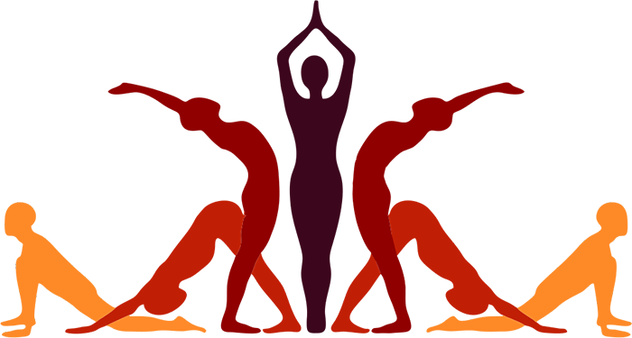
Introduction
Definition of Yoga
Yoga is a spiritual and ascetic discipline that originated in ancient India.
The term "Yoga" is derived from the Sanskrit word "Yuj," which means to unite.
It signifies the union of the individual consciousness with universal consciousness, emphasizing a holistic approach to health and well-being.

Slide 59
Origins of Yoga
Prehistoric Era
Indus Valley Civilization: Archaeological findings from the Indus Valley Civilization (circa 3000 BCE) suggest early forms of yoga. Seals depicting figures in meditative postures, resembling modern-day asanas, have been found, indicating the practice's ancient roots.
Proto-yogic Postures: These postures suggest a primitive form of yoga that involved physical and spiritual practices aimed at self-discovery and harmony.
Classical Period
Development of Hatha Yoga: Hatha Yoga emerged between the 9th and 11th centuries. It focuses on physical postures (asanas) and breathing techniques (pranayama) to prepare the body for meditation and spiritual practices.

Slide 60
Origins of Yoga
Integration with Ayurveda and Other Traditional Systems
Yoga is closely linked with Ayurveda, the traditional Indian system of medicine. Both emphasize balance, prevention, and the interconnectedness of body, mind, and spirit.
Yoga is an integral part of India's cultural heritage and is recognized as a valuable contribution to global health and well-being.
Yoga in Contemporary Times
Yoga has become a global phenomenon, often adapted to fit contemporary lifestyles.
While this has increased its popularity, it has also led to debates about the commercialization and dilution of traditional practices.
The practice of yoga is now widely recognized for its physical, mental, and spiritual benefits.

Slide 61
Yoga: Way of Life

Slide 62
Yoga Way of Life
Work-life balance is a significant challenge in modern society.
Many employees feel deprived of meaning in their workplaces.
This leads to considerable stress, both physical and psychological.
Workers face increasing demands to work extended hours, resulting in work overload.
There is growing concern about burnout in modern corporations, non-profits, and government organizations.
Burnout results from unmanaged stress, causing symptoms like
Exhaustion
Irritation
Ineffectiveness
Discounting of self and others
Health problems (hypertension, ulcers, heart issues)

Slide 63
Yoga Way of Life
Consequences of burnout include reduced workplace productivity, bad health, and mental stress.
Unaddressed burnout can become a social problem over time.
Workplace stress spills into personal and social life, affecting the individual and family members.
Costs of stress are significant and encompass these costs -
Financial costs
Mental costs
Physical costs
Social costs

Slide 64
Yoga Way of Life
A psychologically stressed individual suffers from ill health (both mental and physical).
Medical practitioners treat stress-induced chronic conditions like hypertension and diabetes with medicines and lifestyle changes.
Salient lifestyle changes for a healthy life are found in the yoga way of life.
India has a rich repository of knowledge and experience on yoga as a means to a healthy life.
Yoga is gaining greater international attention recently.
As a holistic science, yoga addresses all aspects of human functioning.
Principles and practices of yoga provide a comprehensive framework to understand and eliminate psychological and physical stress.

Slide 65
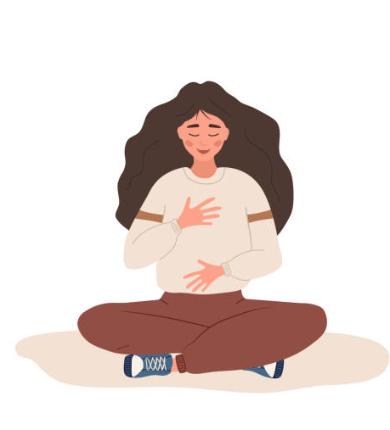
Yoga Way of Life
Yoga is one of the six philosophical systems.
Patanjali proposed yoga to progressively still the mind by working on mental fluctuations.
Yoga Sutras outline a method to live a life fostering moderation and promoting harmony.
The uniqueness of the yoga way of life lies in its integrated approach to addressing both physical and psychological aspects.
According to yoga, we are often unconscious of mental and emotional processes that create stress.
Yoga involves a systematic method to expand awareness of these processes and gain control over them.

Slide 66

Yoga Way of Life
In stress disorders, para-sympathetic auto-nervous mechanisms often fail to minimize the impact of stressful stimuli.
Yoga has the potential to influence auto-nervous mechanisms, restoring the functioning of sympathetic and parasympathetic nervous systems.
This prevents the build-up of stress.
Yoga provides tools and techniques to expand conscious awareness into unconscious parts of the mind.
This awareness helps identify patterns and habits that lead to stress.
Raja yoga focuses on controlling the mind through the practice of Ashtanga yoga, the eight-fold path given by Patanjali in the Yoga Sutras.

Slide 67

Yoga Way of Life
The yoga way of life addresses three aspects of one's life
Physical exercises to maintain fitness, nimbleness, and flexibility.
Meditation practices to calm the mind and provide psychological stability.
Ideas to reorient goals and worldviews, promoting realism in living.
These practices help achieve stable and balanced physical and psychological states.
This stability enables individuals to reach health and wellness goals.
The eight steps of Ashtanga yoga help enhance cognitive learning and moral conduct by involving systematic and continuous physiological and psychological practices.

Slide 68
Yoga Way of Life and Health

Slide 69
Yoga Way of Life
Yama and Niyama involve moderating external behavior and thought patterns through mental and physical practices.
Behavioral practices include abstaining from violence, falsehood, dishonesty, sexual excess, and acquisitive tendencies.
Ideals prescribed include purity, contentment, austerity, self-study, and forbearance.
Prolonged and diligent practice helps remove negative emotions like anger, jealousy, greed, attachment, ego, and excessive desire.
These practices are crucial in adopting the yoga way of life.
Through this process, individuals attain 'citta-suddhi' or purity of mind, the beginning of the yoga way of life.

Slide 70
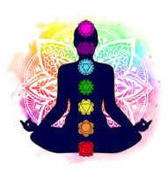
Yoga Way of Life
Asana and Pranayama stages discipline the body and regulate subtle energy flows.
Mastery and regular practice of these stages provide a healthy physical infrastructure and make the mind subtler, alert, and more observant.
In the fifth stage, Pratyahara, secondary inputs are regulated to prevent distraction.
By addressing external stimuli through these five stages, individuals gain control over their minds.
Yoga works on the subtle aspects of one's mind through the stages of Dharana, Dhyana, and Samadhi.
These stages uplift one's spiritual self and heighten consciousness.

Slide 71


Yoga Way of Life
Practices such as asanas, pranayama, and kriyas are physical exercises taught in yoga.
Meditation techniques are integral to the training for the yoga way of living.
Various meditation practices work at the mental level to develop awareness within oneself.
These practices aim to bring about changes in emotional, intellectual, and somatic functions.
Yoga offers a well-formulated approach to lead a life characterized by health and wellness objectives.
Through yoga, individuals become more self-aware and self-regulated.

Slide 72
Physical Exercise-Yoga (Asanas)

Slide 73
Yoga (Asanas)
Eight limbs of Yoga (Ashtanga Yoga) outlined in Patanjali's Yoga Sutras and their impact on health and well-being.
The Eight Limbs of Yoga
Yama (Ethical Observances): These principles guide moral conduct and social behavior. Examples include non-violence, truthfulness, and non-stealing.
Niyama (Self-Discipline): These practices promote self-control and inner purity. Examples include cleanliness, contentment, and self-study.
Asana (Physical Postures): Yoga postures improve flexibility, strength, and bodily control.
Pranayama (Breath Control): Breathing exercises regulate prana (life force) and enhance mental clarity.

Slide 74
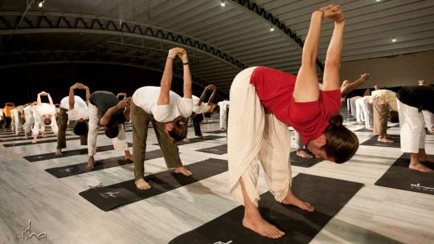
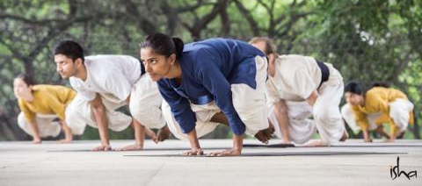
Yoga (Asanas)
Pratyahara (Sensory Withdrawal): This practice involves withdrawing the senses from external distractions to focus inward.
Dharana (Concentration): Here, the mind is trained to focus on a single point.
Dhyana (Meditation): This is a state of deep meditative absorption.
Samadhi (Enlightenment): This is the ultimate goal, a state of perfect union with the divine.

Slide 75
Yoga (Asanas)
Limb | Description | Components
Yama | Ethical Restraints | Ahimsa (Non-violence), Satya (Truthfulness), Asteya (Non-stealing), Brahmacharya (Moderation), Aparigraha (Non-greed)
Niyama | Self-Discipline and Spiritual Observances | Saucha (Cleanliness), Santosha (Contentment), Tapas (Austerity), Svadhyaya (Self-study), Ishvara Pranidhana (Surrender)
Asana | Postures | Physical postures practiced in yoga
Pranayama | Breath Control | Techniques to control and regulate the breath
Pratyahara | Withdrawal of the Senses | Drawing awareness inward
Dharana | Concentration | Focused concentration on a single point or object
Dhyana | Meditation | Sustained and uninterrupted meditation
Samadhi | Union or Integration | Complete absorption and unity with the object of meditation

Slide 76
Yoga (Asanas)
અંગ (Limb) | વર્ણન | ઘટકો
યમ | નૈતિક નિયંત્રણ | અહિંસા (અહિંસા), સત્ય (સત્યવાદિતા), અસ્તેય (ચોરી ન કરવી), બ્રહ્મચર્ય (મર્યાદા), અપરિગ્રહ
નિયમ | સ્વનિયંત્રણ અને આધ્યાત્મિક અનુસરણ | શૌચ (સ્વચ્છતા), સંતોષ (સંતોષ), તપસ (કઠોરતા), સ્વાધ્યાય (આપમંથન), ઈશ્વર પ્રણિધાન (ઈશ્વરપ્રણિધાન)
આસન | સ્થિતિઓ | યોગમાં કસરતની સ્થિતિઓ
પ્રાણાયામ | શ્વાસનિયંત્રણ | શ્વાસને નિયંત્રિત અને નિયમિત કરવાની તકનીકો
પ્રત્યાહાર | ઇન્દ્રિયોને પાછું ખેંચવું | જ્ઞાનને અંદર તરફ દોરવું
ધારણા | ધ્યાન | એક બિંદુ અથવા વસ્તુ પર કેન્દ્રિત ધ્યાન
ધ્યાન | ધ્યાન | સતત અને અવિરત ધ્યાન
સમાધિ | એકતા અથવા સંકલન | ધ્યાનની વસ્તુ સાથે સંપૂર્ણ સમરપણ અને એકતા

Slide 77
Mental Exercises: Meditation-Yoga (Pranayama, Sukshma Kriyas)

Slide 78
Meditation
A practice where an individual uses techniques such as mindfulness, or focusing the mind on a particular object, thought, or activity to train attention and awareness.
Reduces stress, improves concentration, promotes emotional health, enhances self-awareness, and lengthens attention span.

Slide 79

Basic Meditation Techniques
Mindfulness Meditation
Focus on breathing
Observe thoughts without judgment
Body Scan Meditation
Progressively focus on different parts of the body
Promote relaxation and body awareness
Guided Meditation
Follow instructions from a guide or recorded session
Use of imagery and visualization for relaxation

Slide 80
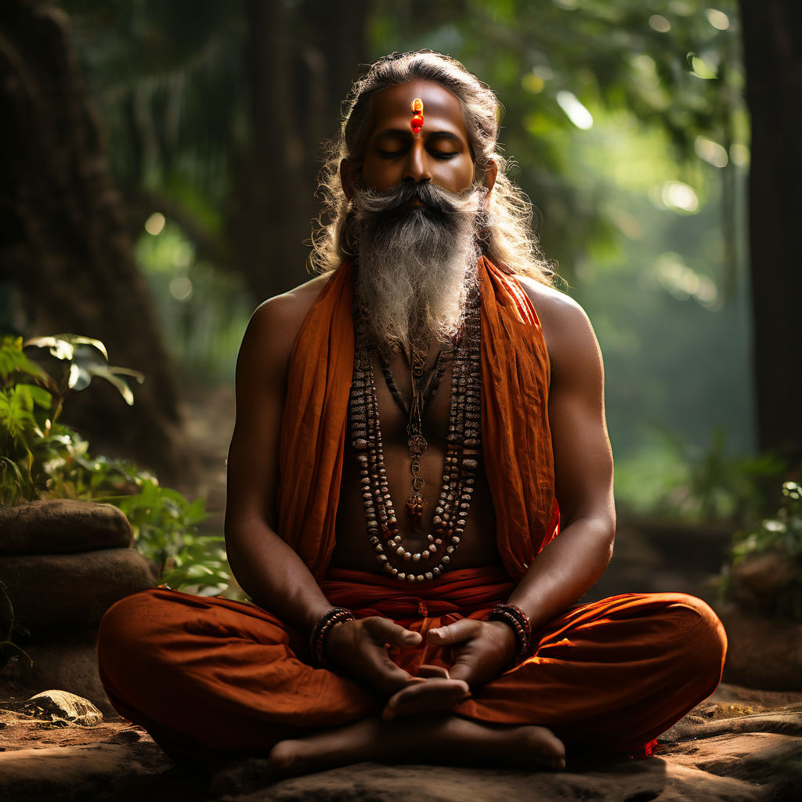
Yoga: Pranayama
The practice of breath control in yoga.
"Prana" means life force or breath sustaining the body; "ayama" means to extend or draw out.
Improves respiratory function, reduces stress, balances energy levels, and enhances mental clarity.
Basic Pranayama Techniques
Anulom Vilom (Alternate Nostril Breathing)
Kapalabhati (Skull Shining Breath)
Bhramari (Bee Breath)
Ujjayi (Ocean Breath)

Slide 81


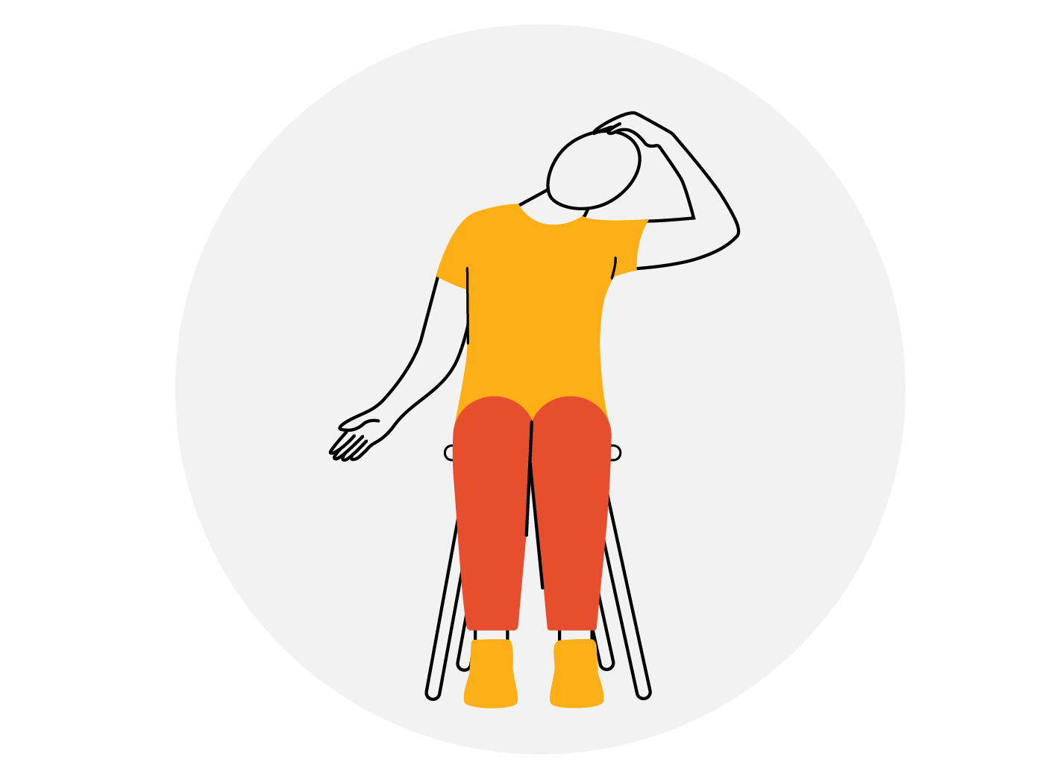

Yoga: Sukshma Kriyas
Subtle exercises or micro-movements that promote relaxation and enhance the flow of energy within the body.
Improve circulation, reduce tension, enhance flexibility, and prepare the body for meditation and deeper yoga practices.
Basic Sukshma Kriyas Techniques
Neck Exercises
Gentle neck rotations to relieve tension
Move the head up and down, left and right
Shoulder Exercises
Shoulder shrugs and rotations to release stress
Raise and lower shoulders in a rhythmic motion

Slide 82
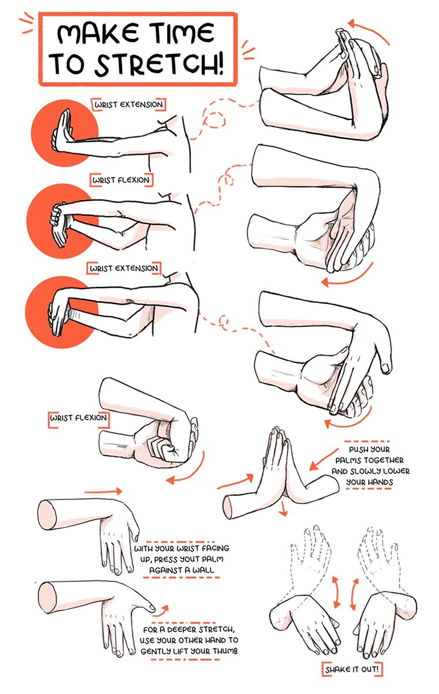
Yoga: Sukshma Kriyas
Basic Sukshma Kriyas Techniques
Hand and Wrist Exercises
Clench fists and release to improve blood flow
Rotate wrists in both directions
Eye Exercises
Blink rapidly to moisten the eyes
Focus on a near object and then a far object to strengthen eye muscles
Ankle and Foot Exercises
Rotate ankles and flex the feet to enhance circulation
Point and flex toes repeatedly

Slide 83
Importance of Balanced Life

Slide 84
Importance of Balanced Life
Reduces Negative Emotions: Yama and Niyama help eliminate negativity like anger, jealousy, and greed, promoting emotional well-being.
Enhances Self-Awareness: Pranayama and Pratyahara practices increase self-awareness by quieting the mind and regulating sensory inputs.
Improves Mental Clarity: Asana, Pranayama, and meditation practices promote mental focus and clarity.
Reduces Stress and Anxiety: Techniques like meditation and Pranayama help regulate the nervous system, reducing stress and anxiety.
Supports Physical Health: Asana practices improve flexibility, strength, and bodily functions.

Slide 85
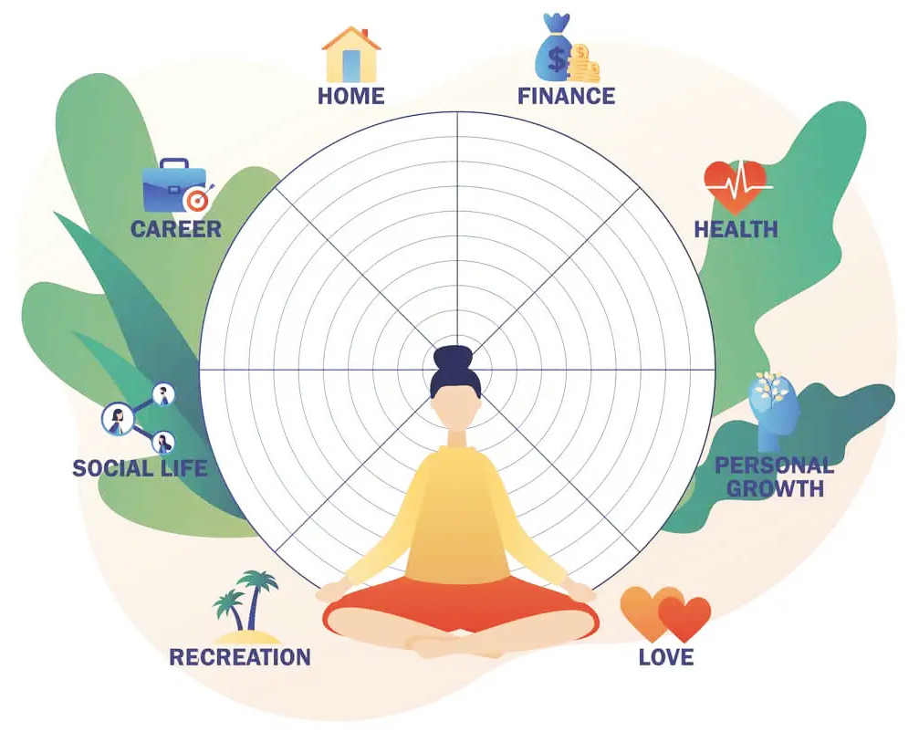
Importance of Balanced Life
Studies support the positive effects of Yoga such as
Heart rate reduction
Management of stress and anxiety
Blood pressure regulation
Cholesterol reduction
Overall, Yoga is a well-structured approach to health and well-being, promoting a balanced mind, body, and spirit.

Slide 86
Smriti
Shruti
Vedanga
Puranas
Rig
Veda
Yajur
Veda
Brahmans
Upanishads
Smriti Darshana Shastras
Upvedas
Vedic Literature
Maha Kavyas
Shad Darshanas
Atharva
Veda
Sama
Veda
Aryanakas
Samhitas

Slide 87
Thank You
Indian Knowledge System
#2301DU005

